Slide 1
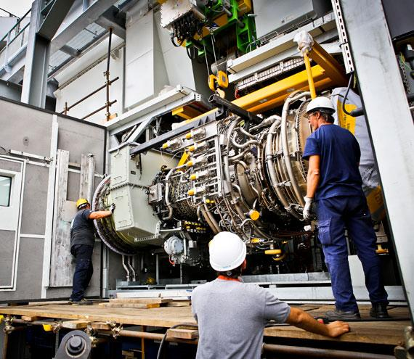

ESNAD Blending Facility

Slide 2

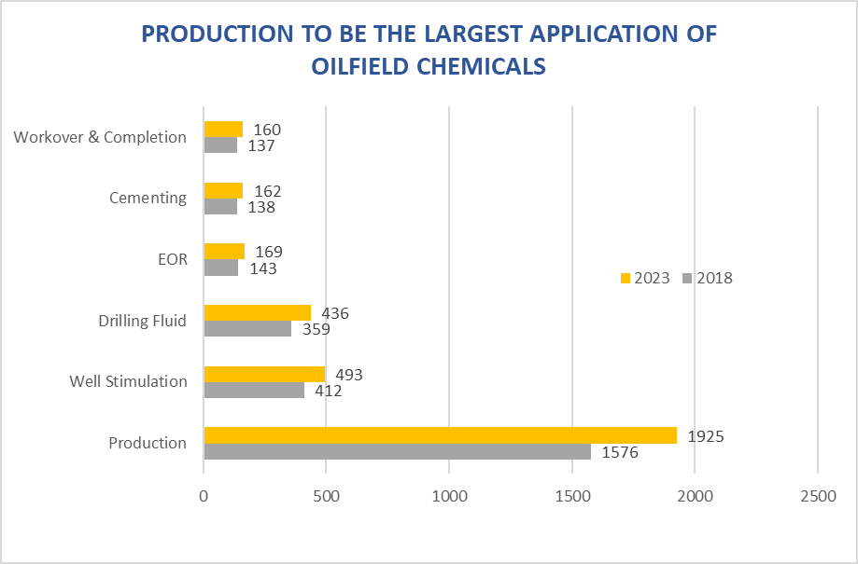
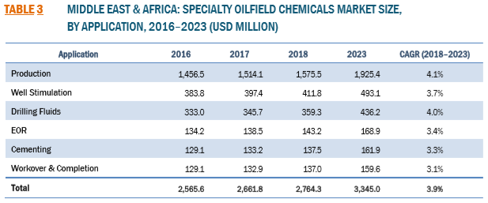
Oilfield Chemicals Market Size

Slide 3
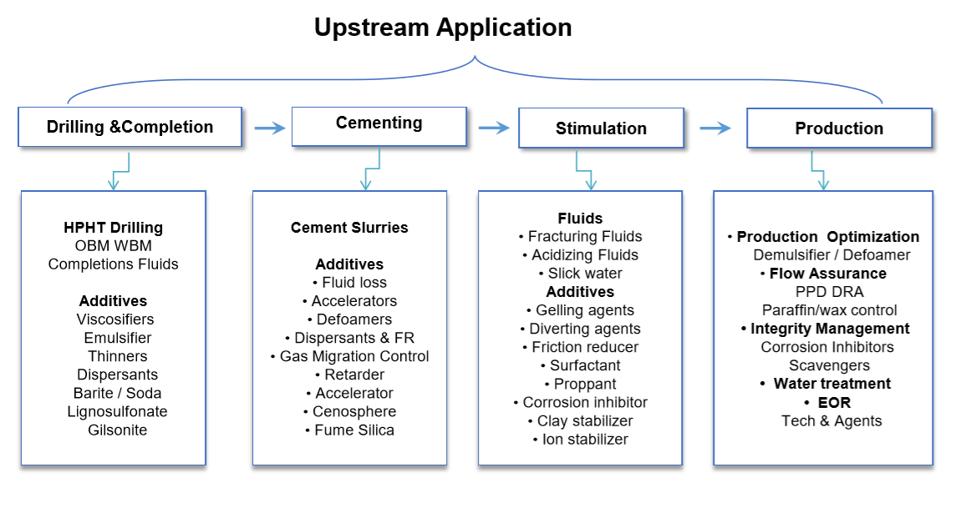
Oilfield Chemicals Segments

Slide 4
R&D Based Developed Drilling Specialty Chemicals
Challenges | Additives
Shale Instability Problems
Hole Cleaning
Rheology Control Problem
Corrosion Problem/Contamination Problem/Bacterial Degradation Problem
Torque & Drag Problems
Cleaning Problems
Stuck Pipe Problem
HPHT Wells Problems
Loss Circulation

Slide 5
R&D Based Developed Production Specialty Chemicals
Category | Additives
Biocides, Corrosion Inhibitors and Scavengers
Wax and Asphaltene Inhibitors
Emulsion Breakers (Demulsifiers)
Scale Inhibitor
Hydrate Inhibitor
Iron Removal
Waste Water Treatment Specialty Chemicals
Corrosion Inhibitors/Scavengers/Preservative

Slide 6
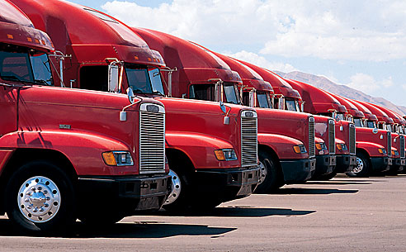
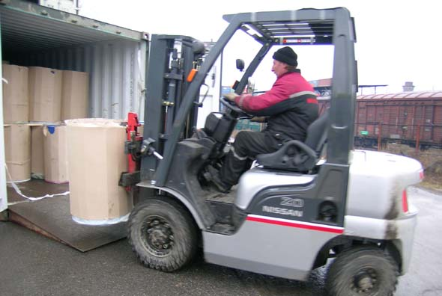


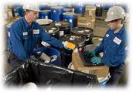
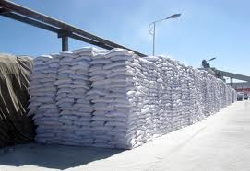
Vision
Formation of a highly reputable local blending facility that provides numerous products, services & solutions to industry in Iraq and MENA region.
Supporting these activities by maintaining fully equipped facilities, including Laboratory, sizable warehousing & offices as well as a complete distribution network all staffed by personnel who are able to package and prepare the appropriate solution for the customers within the Sultanate & Overseas.
Key operations need to be in place while leaving a multitude of important tasks to this Organization, examples include:
Sales & Marketing
Customs Clearance & Forwarding
Financial Services
Infrastructure & Logistical Support such as offices & warehousing, transportation & delivery, personnel and general management

Slide 7
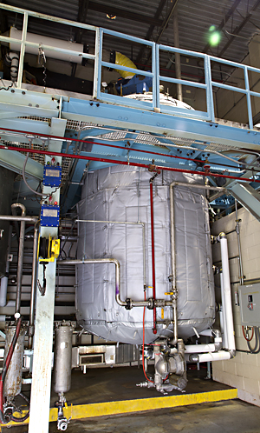

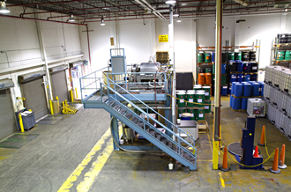
Chemical Blending Roadmap
Phase 1
Blending
Chemical mixing
Dispersions & Emulsions
Focus on Production chemicals & Drilling Products
Analytical capabilities and product customization
Phase 2
Blending and Chemical Reactions
Creating new molecular entities through chemical reactions of gaseous, liquid or solid raw materials
Advance analytical capabilities
Phase 3
Product Development
Synthesis and process development
Applications testing lab
Scale up and pilot plant facilities

Slide 8
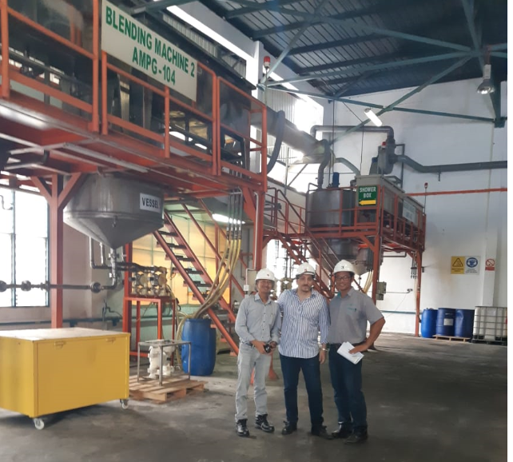
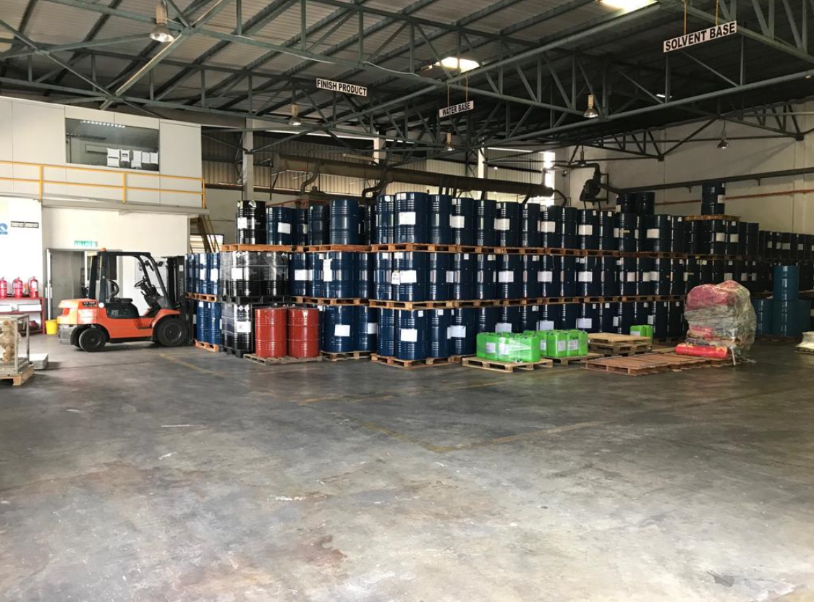
Chemical Blending Roadmap
Investment requirement for a Medium Size Fit for Purpose Blending Facility is $900k-$1Million.
Detailed Feasibility Study will be shared with Potential Share Holders.

Slide 9
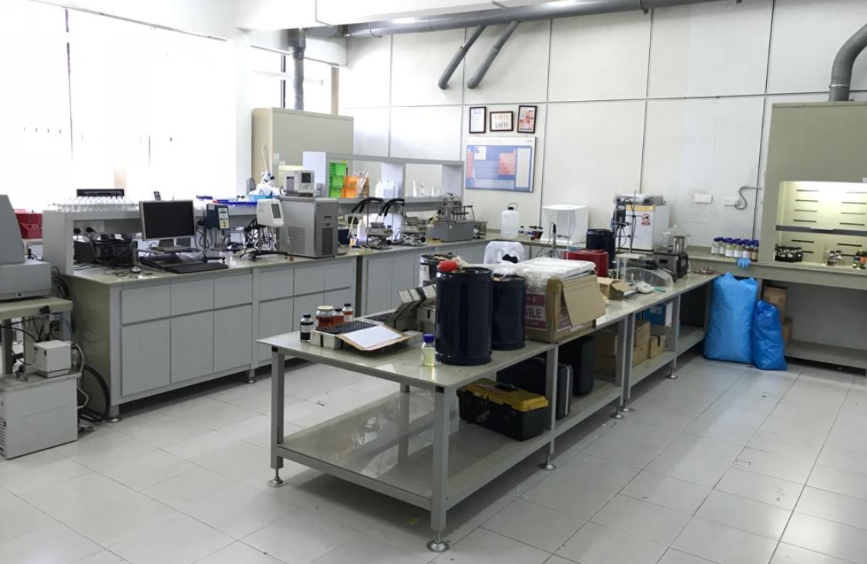
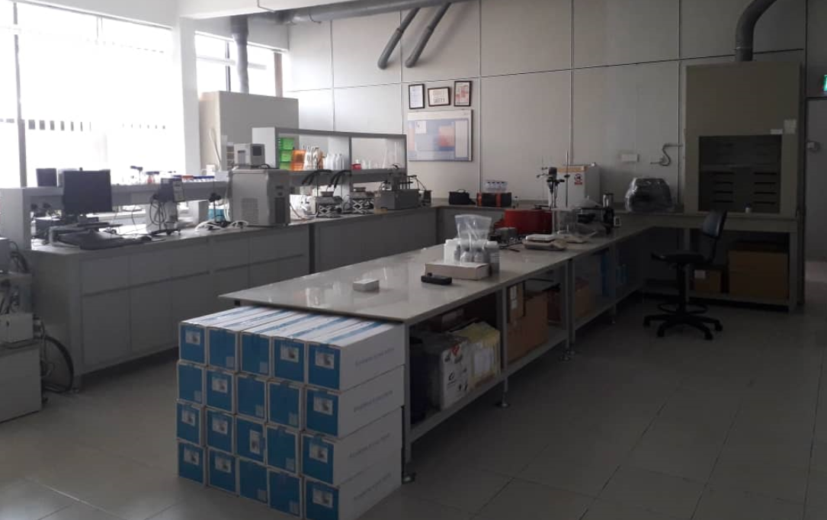
Laboratory
Full Range Laboratory can be set up which will take care of the Production Chemicals as well as Quality testing like Barite, Bentonite, Calcium Carbonate, Liquid Blending, Solid Blending and all related mud additive used in Water Base Mud, Oil Base Mud, etc.
Lab will be built to do Quality Test, Customization of Products specifically for Demulsifiers and Future product development.
Size 400-500 sqft

Slide 10
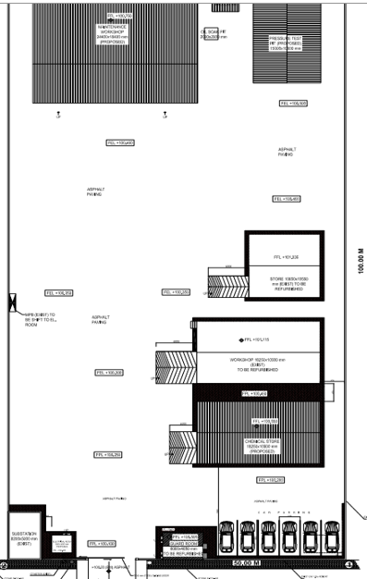
Proposed Layout.
Ideally we should have 10,000 sq M land for such project especially if we want to go for Phase 2 expansion.
If not available, 7000 sq M can be sufficient even for future expansion.

Slide 11
Financial Snapshot

Slide 12



Thank you
Contact Us
Address:
PO Box 786, PC 116
MAF, MUSCAT, Oman
(+968) 24390846
www.esnad-int.com

